Slide 1
MINI PROJECT “HEART DISEASE PREDICTION SYSTEM USING MACHINE LEARNING ALGORITHM”
NAME: Chetan Lunthi
UNIVERSITY ROLL NO: 2118462
Section: K
Roll no: 19
b.Tech cse (5th sem)

Slide 2
CONTENT
Introduction
Problem statement
Motivation
Objective
Literature Survey
Proposed model in base paper
Algorithm used in base paper
Application
Summary

Slide 3
INTRODUCTION
It is difficult to identify heart disease because of several contributory risk factors such as diabetes, high blood pressure, high cholesterol, abnormal pulse rate and many other factors.
Among various life threatening diseases, heart disease has garnered a great deal of attention in medical research.
The diagnosis of heart disease is a challenging task, which can offer automated prediction about the heart condition of patient so that further treatment can be made effective.
The diagnosis of heart disease is usually based on signs, symptoms of the patient.
The severity of the disease is classified based on various methods like K-Nearest Neighbor Algorithm (KNN), Decision Trees (DT), Gradient boosting algorithm (GA),Random forest(RF), and Naive Bayes(NB).
The nature of heart disease is complex and hence, the disease must be handled carefully. Not doing so may affect the heart or cause premature death.

Slide 4
Problem Statement
Heart disease prediction using machine learning algorithm

Slide 5
MOTIVATION
A major challenge facing healthcare organizations is the provision of quality services at affordable costs.
Quality service Implies diagnosing patients correctly and administering treatments that are effective.
Poor clinical decisions can lead to disastrous consequences which are therefore unacceptable.
Hospitals must also minimize the cost of clinical tests.
They can achieve this results by employing appropriate computer based information and decision support system.

Slide 6
OBJECTIVE
The main objective of this research is to develop a heart prediction system, the system can discover and extract hidden knowledge associated with diseases from heart data set.
This system aims to exploit machine learning techniqyes on medical data set to assist in the prediction of heart disease
Reduce the cost of medical tests
To help avoid human biases

Slide 7
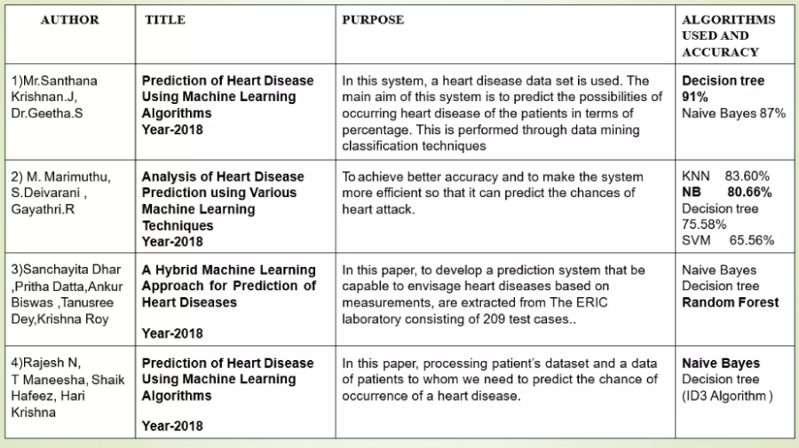
LITERATURE SURVEY

Slide 8
METHODOLOGY
To create this project we have used jupyter notebook .
In the medical field, it is currently a very active research area and in the future, it will be widely used in the biomedical system.
We have also used decision tree , random forest, gradient boosting ,KNN .It is perfect for figuring out whether the person is suffering from heart disease or not.Since no unique set of rules is needed on how the ailment is diagnosed
.The Federated Learning approach is differing from traditional machine learning techniques it's miles a rising approach that could be very useful in price saving and security

Slide 9
MODULE DISCRIPTION
UPLOAD TRAINING DATA-Rule generation advanced in two states during the first stage the model is built using training set
DATA PRE-PROCESSING-Heart disease data is pre-processed after collection of various records .The dataset contain 1030 patient records.
PREDICTING HEART DISEASE- The training set is different from test set. In this study , we used this method to verity the universal applicability of the methods
GRAPHICAL REPRESENTATION-The analyses of proposed system are calculated based on the approval and disapproval this can be measured with the help of graphical notation such as barchart the data can be given in a dynamical data

Slide 10
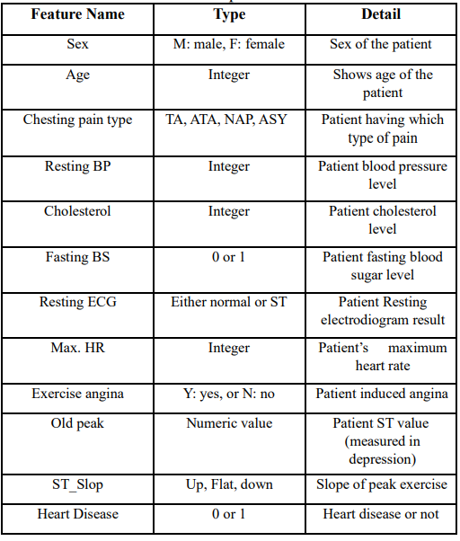
ATTRIBUTES AND DISCRIPTION OF HEART DISEASE DATA SET

Slide 11
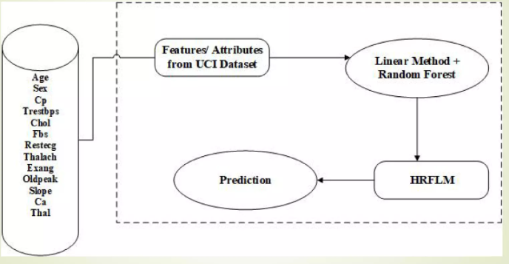
PROPOSED MODEL

Slide 12
PACKAGES USED
from sklearn.preprocessing import StandardScaler
from sklearn.model_selection import train_test_split
from sklearn.linear_model import LogisticRegression
from sklearn import svm
from sklearn.neighbors import KNeighborsClassifier
from sklearn.tree import DecisionTreeClassifier
from sklearn.ensemble import RandomForestClassifier
from sklearn.ensemble import GradientBoostingClassifier
from tkinter import *import joblib

Slide 13
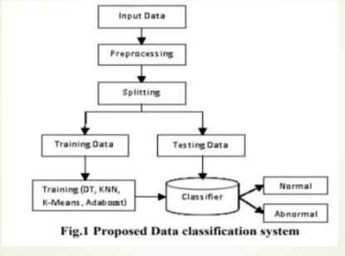
PROPOSED MODEL

Slide 14
APPLICTAIONS
Medical Institutions: To teach medical students how the heart attack been measured , or how to identify that the person is suffering from heart disease.
Hospitals : To detect that is the person having heart disease or not.

Slide 15
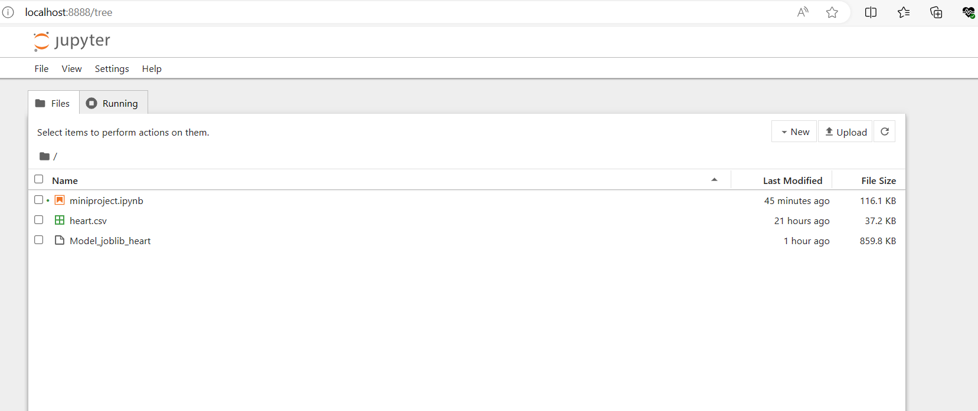
JUPYTER NOTEBOOK

Slide 16
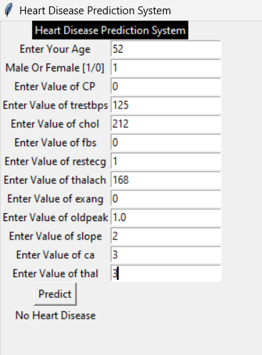
GUI MODEL

Slide 17
CONCLUSION
Many people suffered heart damage as a result of major coronavirus epidemic, according to experiments. As a result, research is warranted to develop a suitable diagnostic method that focuses on the incidence of heart failure and can detect it early enough to prevent death.
It assists patients in diagnosing heart illness regarding medical information from past heart disease diagnoses.
The RANDOMFOREST approach was used to build this model. The model has a 85.47 percent accuracy. Using additional training data raises the risk of the model correctly detecting cardiac illness.
To simplify data and compare outcomes, several methods might be performed. Additional techniques to link trained ML and DL cardiac models with specific multimedia can be found for the convenience of patients and clinicians.

Slide 18
THANK YOU

